Slide 1

THE GOVERNMENT OF BRITISH COLUMBIA
RISK ASSESSMENT REPORT

Slide 2
INTRODUCTION
As computer users become informed, there are greater risks of sensitive data kept on network servers being compromised or stolen.
To reduce these potential risks, this report will expand on recommendations for proper risk management practices and identify potential threats as well as weaknesses.

Slide 3
SECURITY DOMAINS
DOMAINS | DOMAINS
ORGANIZATION OF INFORMATION SECURITY | OPERATIONS SECURITY
HUMAN RESOURCE SECURITY | COMMUNICATIONS SECURITY
ASSET MANAGEMENT | SYSTEM ACQUISITION, DEVELOPMENT & MAINTENANCE
ACCESS CONTROL | SUPPLIER RELATIONSHIPS
CRYPTOGRAPHY | INFORMATION AND SECURITY INCIDENCE
PHYSICAL AND ENVIRONMENTAL SECURITY | INFORMATION SECURITY ASPECTS OF BUSINESS CONTINUITY
SECURITY POLICY | COMPLIANCE

Slide 4
METHODOLOGY & APPROACH
• An Executive Dashboard designed to give the board and senior executives a brief, high-level report.
• A Priority Roadmap containing strategic recommendations for improvement; including the risk, the recommended future situation, and residual risk.
• Specific questions and responses gathered during weekly assessment with data owners.
• Guidance and best practices with developing areas that require improvement.

Slide 5
SUMMARY DASHBOARD
OVERALL SCORE
85%

Slide 6
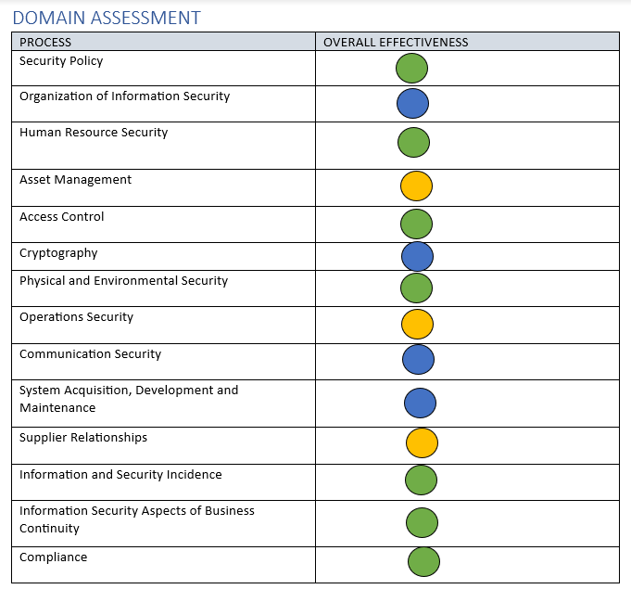
DOMAIN ASSESSMENT

Slide 7
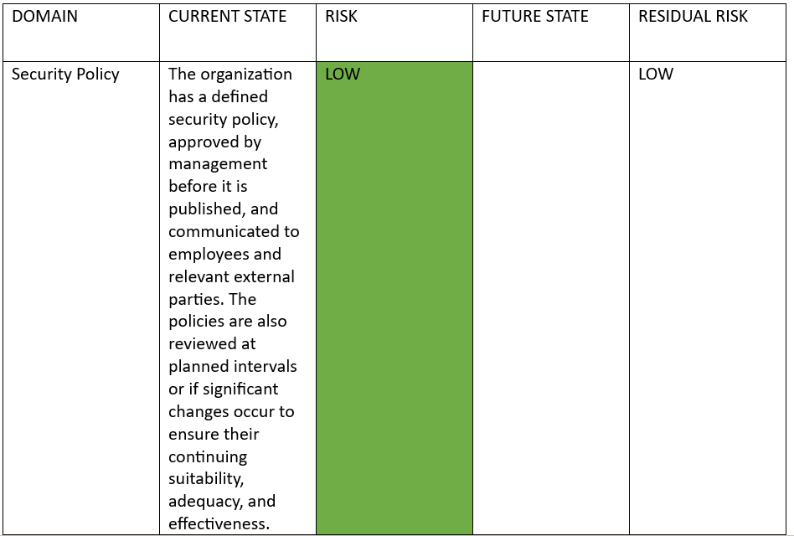
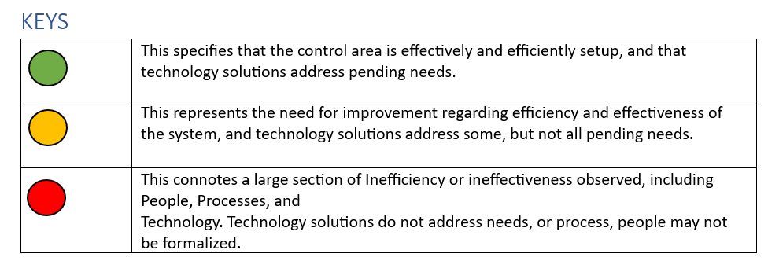
PRIORITY ROADMAD -LOW RISK

Slide 8
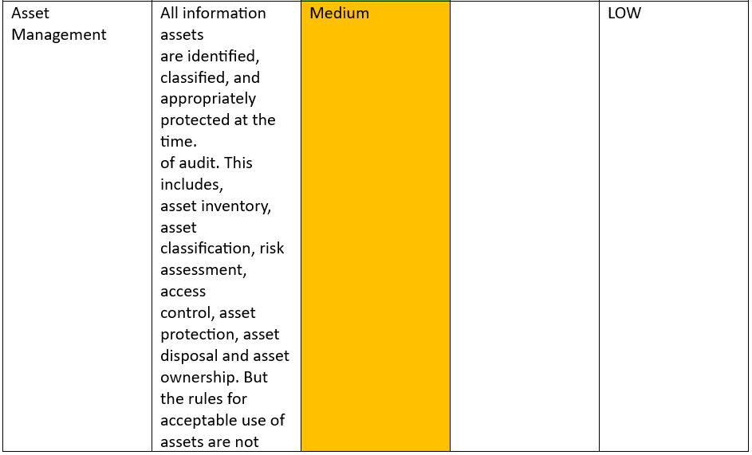
PRIORITY ROADMAP -AVERAGE RISK

Slide 9
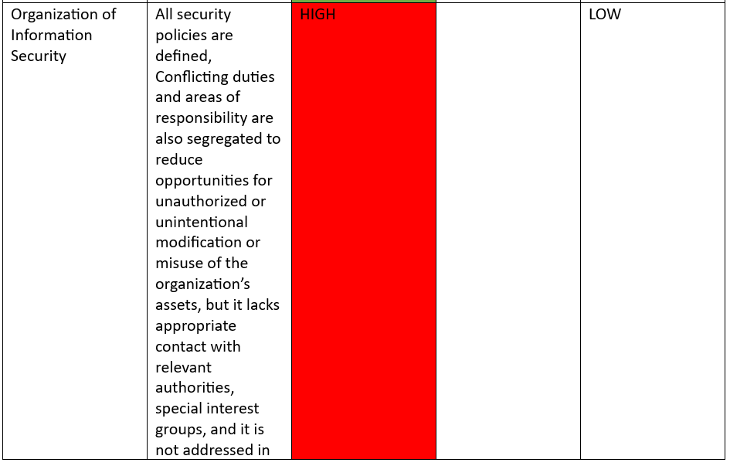
PRIORITY ROADMAP -HIGH RISK

Slide 10
RECOMMENDATIONS | JUSTIFICATION
The Use of Network Access Control | It allows the organization to enforce access controls and security policies across their network, ensuring that only authorized users and devices are granted access. It helps prevent unauthorized access and can mitigate the risk of security breaches, data theft, and other cyber-attacks
Improve Cryptographic Controls | To improve the confidentiality, integrity, and availability of data, it is recommended to upgrade to AES-512 and TLSv1.3 for additional security.
The use of Multifactor Authentication on VPN | Adopting multifactor authentication on their VPN provides additional layers of authentication asides username and password, making it more difficult for unauthorized users to gain access to the VPN
Adopting the Use of CI/CID Tools | Automating the software aids delivery process, and better team productivity and efficiency.
The implementation of more environmental control | To guarantee that the institution complies with specific environmental standards and controls

Slide 11
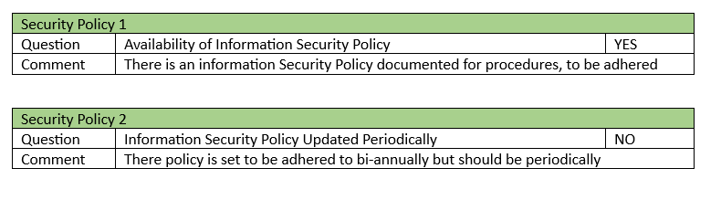
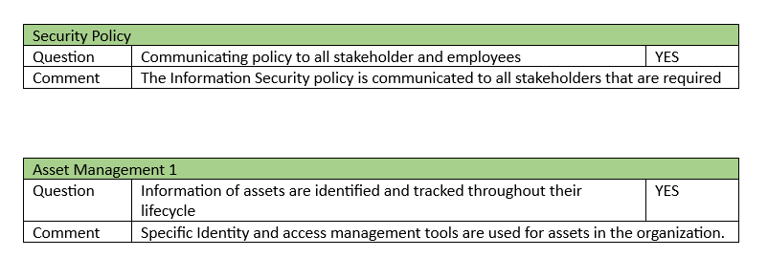
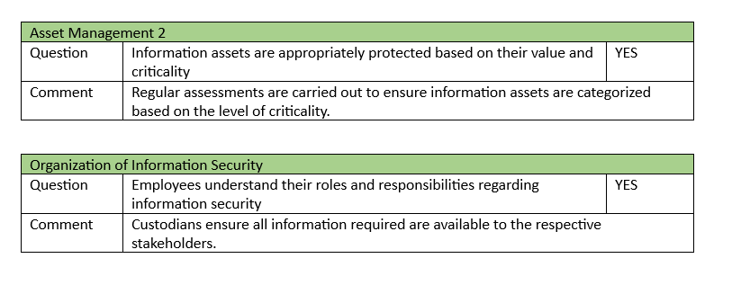
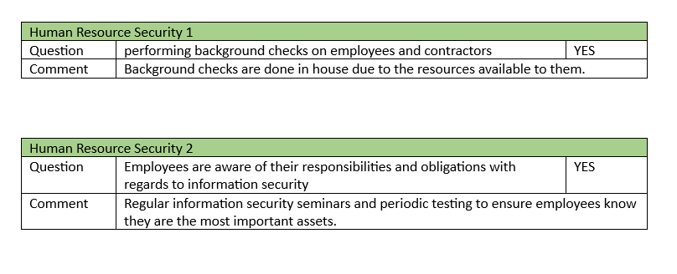
ASSESSMENT QUESTIONS AND ANSWERS

Slide 12
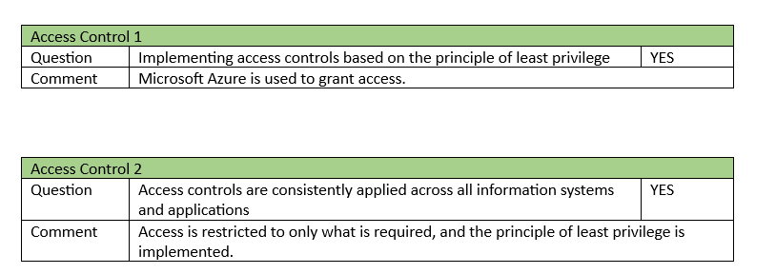
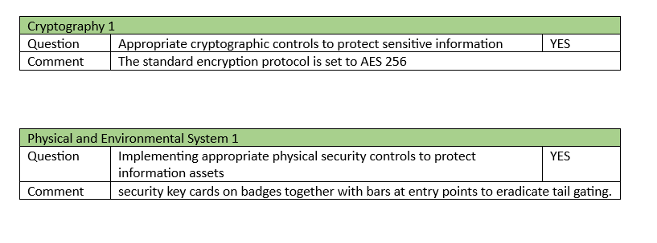
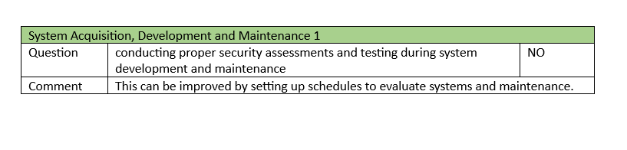
ASSESSMENT QUESTION & ANSWERS

Slide 13

APPENDIX A -GUIDANCE

Slide 14
INFORMATION SECURITY ROLES- SENIOR INFORMATION SECURITY OFFICER
Setting priorities and communicating them
Information Security Procedures
Program Governance and Oversight
Formulates, reviews, and approves information security policies
Assessment of efficacy
Coordination of Security measures

Slide 15
INFORMATION SECURITY ROLES- SECURITY EXPERT
Determines and synchronizes information security strategy and goals with website requirements
Programs for privacy, security, and risk management are formally reviewed and approved to be consistent with organizational goals
Process for managing recognized risks and deciding whether to accept or mitigate them, as documented in the Risk Acceptance Process.
Reviewing the security program periodically

Slide 16
STRATEGIC PLAN
Integrating risk management, performance management, and investment management, will assist in synchronizing information security with corporate goals.
Consistent procedures, proactive decision-making, and a secure unified security environment that smoothly interacts with applications, data, processes, and workflows is the best way to improve the systematic approach in the organization.

Slide 17

APPENDIX B -ARTIFACTS

Slide 18
APPENDIX B –ARTIFACTS REVIEWED
S/N | DOCUMENT NAME
1 | C-CERT Response Plan
2 | Employee Onboarding /Offboarding Document
3 | Backup Policy 2023
4 | BC Business Continuity Plan
5 | BC Information Security Policy
6 | BC Asset Management

Slide 19
CONCLUSION
In conclusion, implementing these procedures enables the British Columbian Government Policy to protect itself more effectively by proactively identifying and reducing security risks.

